Slide 1
Phenovar data

Slide 2
DMP data management plan

Slide 3
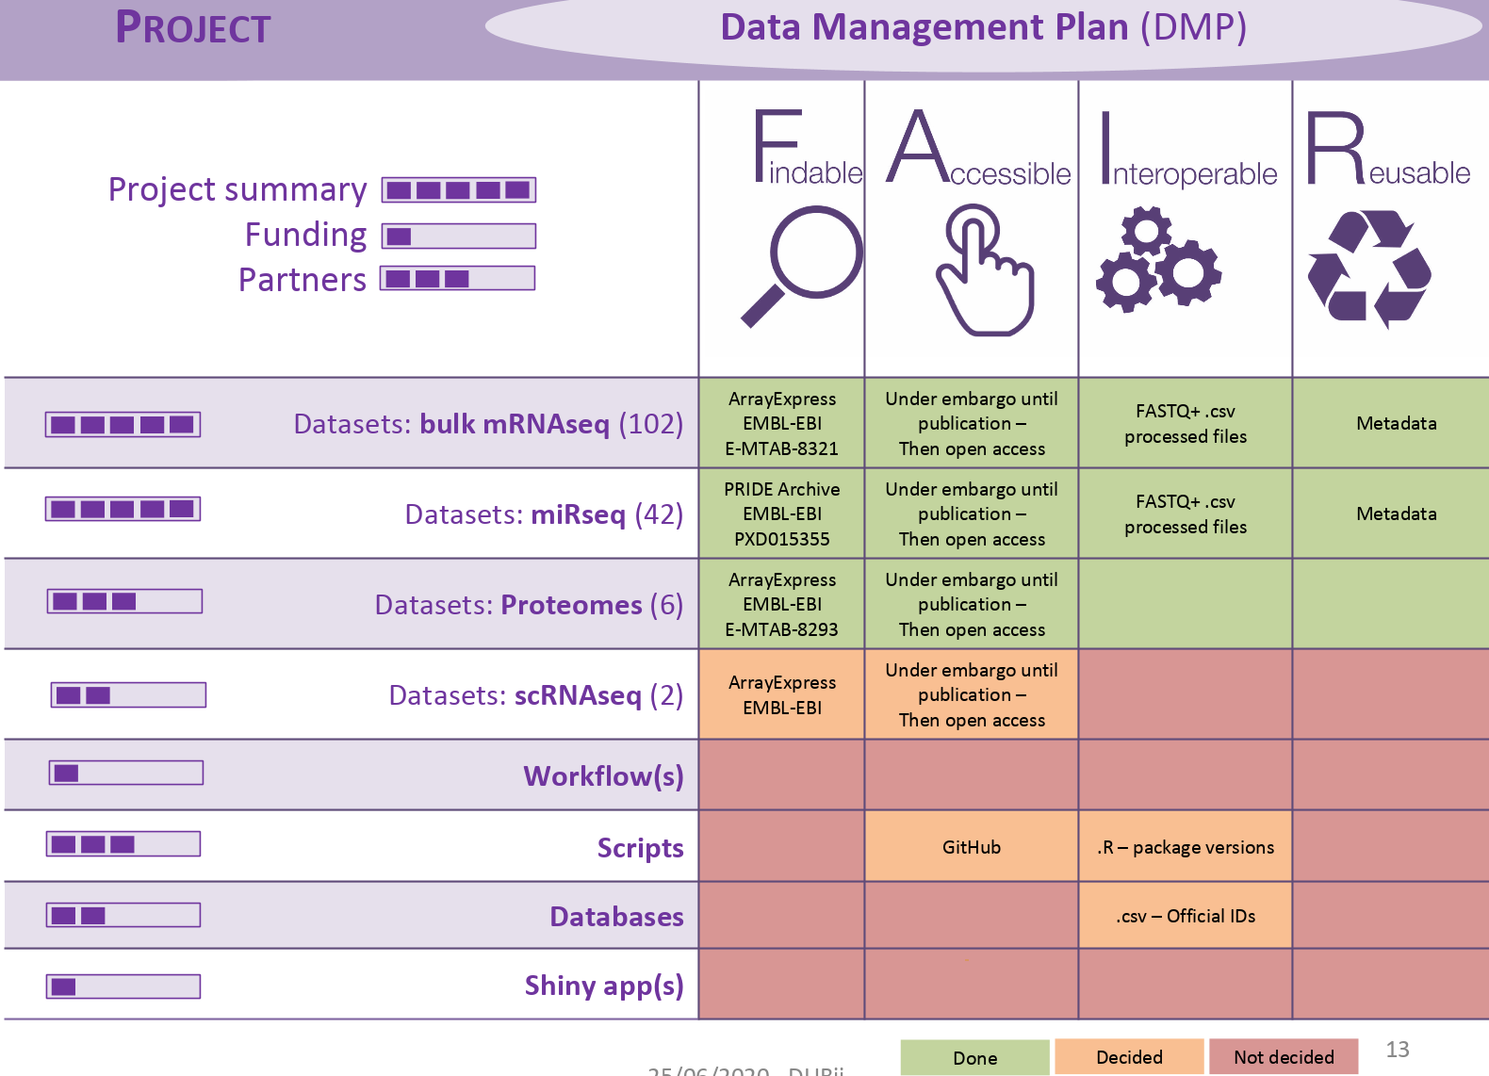

Slide 4
READS: - fasta5 files (95 + 4 n-phase = 99 strains) => they need to be parsed by strain
- fastq files (95 + + 4 n-phase =99 strains =>debarcoded and trimmed)
ASSEMBLIES: fasta files for polished assemblies by Smart de novo (99 + 18 Gigascience = 117 strains)
fasta files for polished assemblies by Canu (99 + 18 Gigascience = 117 strains)
fasta files for scaffolded assemblies by Ragout for Smart de-novo assemblies
(117 strains)
fasta files for scaffolded assemblies by Ragout for Canu assemblies
(117 strains)
fasta files other assemblies (6 Jia-Xing + CENPK + 4 Pacbio Czaja + S288C + 8 Bendixen = 20 strains)
Out of of 117 strains:
- 83 homozygous genomes with final genomes corresponding to one of scaffolded assemblies
- 21 heterozygous diploids with one scaffolded assembly corresponding to the reference genome
for phasing:
fastq files reads splitted in 2 haplotypes
2 new assemblies of each haplotypes (Canu or smart de novo?)
- 13 polyploids (6 triploids and 7 tetraploids)
phased assemblies
split fastq files?
ANNOTATIONS: 117 + 6 Jia-Xing + CENPK + 4 Pacbio Czaja + 8 Bendixen = 136 ggf3 files
SV LISTS: 185 csv files
VCF files
Metadata
4 Tb

Slide 5
Phenovar
data
src
Results
doc
Fasta5
Fastq
scripts
Fasta
Vcf
Csv
Graphs
…
Metadta
Versioning
Publications
…

